Slide 1
Microsoft Viva Learning Adoption Guide
Updated March 2022

Slide 2
Table of contents
01
Intro
Adoption guide overview
02
05
Assess
Understand access requirements
Assess current learning ecosystem
Define target scenarios
Target scenario examples
Assess readiness
Train and Adopt
Build training strategy
Run pilot
Drive a learning culture
Build awareness
03
06
Plan
Define success criteria
Assemble core team
Assign core team R&R
Understand common adoption concerns
Drive
Gather insights
Monitor satisfaction
Reinforce adoption
Deepen engagement
04
07
Deploy
Know user discovery scenarios
Set up and configure Viva Learning
Understand learning content sources
Resources

Slide 3
Adoption guide overview
Adopting new technology brings change, and change can be daunting. The purpose of this document is to help you successfully navigate attaining company-wide adoption of the Microsoft Viva Learning app in Teams. This easy-to-follow how-to guide will walk you through the steps of deploying Microsoft Viva Learning to your organization to help ensure your employees reach their learning objectives.
Purpose of this document
Successful adoption looks like
Alignment
Awareness
Engagement
A clear vision for how to use Viva Learning and proactive senior leadership support
All users are aware of Viva Learning, its value, and how to use it
Long term adoption with data
driven goals and relevant communications

Slide 4
Assess your environment

Slide 5
Understand access requirements
Microsoft or Office 365 subscription
Special considerations
The Viva Learning app will be discoverable to all users with a paid Microsoft or Office 365 subscription and access to Microsoft Teams
GCC tenants – Access is on the for H2 CY2022
EDU tenants – Only faculty & staff will have access for EDU tenants. Students will not have access to Viva Learning
Not required, but can enhance the Viva Learning experience:
SharePoint – Allows for organization-generated resources to show up as learning content in Viva Learning
Existing subscriptions with content providers
LinkedIn Learning
3rd party learning content providers
Existing subscription with Learning Management Systems

Slide 6
Consider your current learning ecosystem
Take inventory of your current learning programs
Does your organization subscribe to any learning content providers (LinkedIn Learning, Skillsoft, Pluralsight, Coursera)?
Does your organization use a learning management system (SAP SuccessFactors, Cornerstone OnDemand, SumTotal)? How do you use it – as a system of record/compliance, to set up required trainings, to get learning reporting/insights, for learning discovery?
Does your organization use a learning experience platform (Degreed, EdCast)? How do you use it – as a front-end user platform, for learning discovery, for organizing their learning goals?
Understand where Viva Learning fits in. Viva Learning is a flow of work learning platform. It is a user-friendly, front-end platform, being fully integrated throughout the programs employees are already using. Viva Learning should be leveraged to maximize the impacts of your other learning investments by bringing them into the flow of work throughout Microsoft Teams and Microsoft 365.
Determine which of your current learning investments integrate with Viva Learning (see the full list of partners on the webpage).
Think about how Viva Learning fills gaps that your other learning investments leave.

Slide 7
Determine target scenarios
Target scenarios describe how your employees will use Microsoft Viva Learning to address business challenges and achieve organizational, cultural, tangible, or individual adoption outcomes.
Target scenarios…
Help you understand how to get the most out of Microsoft Viva Learning
Act as input and validation of Microsoft Viva Learning awareness messaging
Put Microsoft Viva Learning in context so employees know when and how to use it

Slide 8
Target adoption scenario examples: Learner
In a meeting with a colleague, they mention wanting to brush up on their data analysis skills
A sales analyst is searching Office.com for a customer pitch deck to give in an upcoming sales meeting
An employee led a session on Diverse and Inclusive marketing and wants to make it available as a company training
Chat and
conversation
Cross-M365
discovery
Crowdsource learning content
Send a relevant course in a meeting or Teams chat
Include pointers to relevant sections or add context in chat message
Enable peer coaching or mentor relationships – formal or informal
Surface Viva Learning content in Office.com, Microsoft Search, and SharePoint
Bookmark relevant learning courses that appear in search results, such as “Effective sales pitch strategies”
Admins can create a collaborative SharePoint folder connected to Viva Learning for employees (or restricted audiences) to add content
See added content in Viva Learning as learning content

Slide 9
Target adoption scenario examples: Manager
A new team member will be joining
next week
A manager wants to foster a culture
of learning and growth
At a leadership meeting, the VP emphasizes the importance of web presence for the company’s brands
Onboarding
Track progress
Search and recommend
Add a learning tab to your Teams channel for onboarding
Add relevant courses and organization-specific content to the tab
Curate for your team and priorities
Check the status of recommended content in the Manage tab
Give kudos to colleagues who prioritize learning
Search for keywords in the Viva Learning home page or a channel learning tab
See search results from Microsoft, 3P providers, and internal sources
Bookmark interesting courses and recommend courses to peers

Slide 10
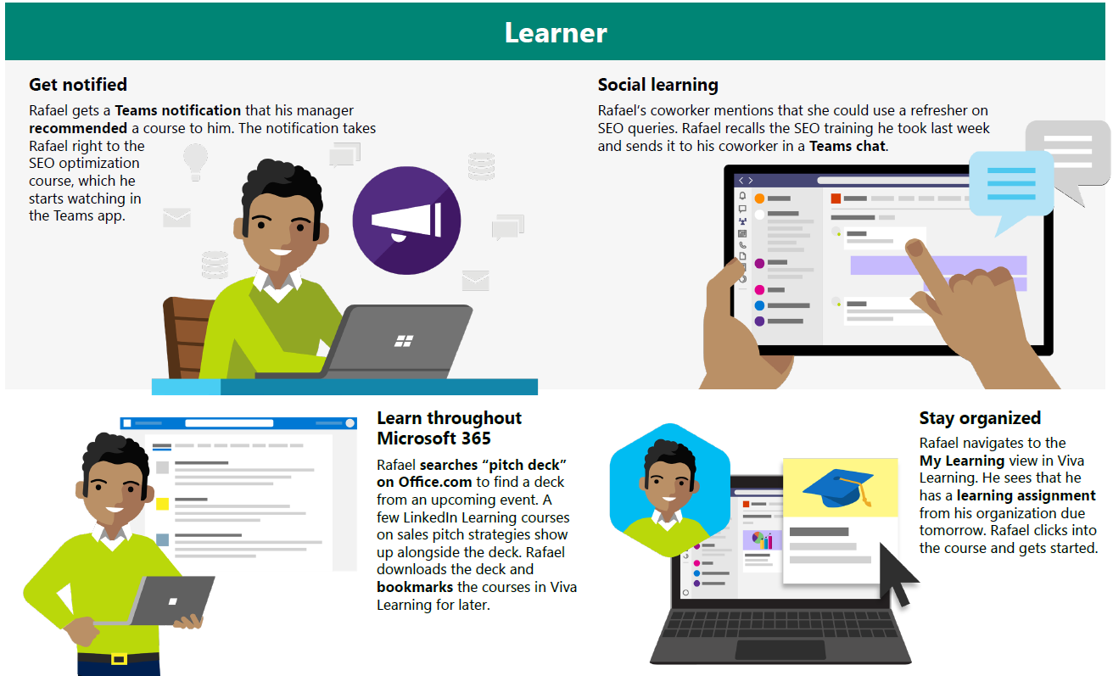
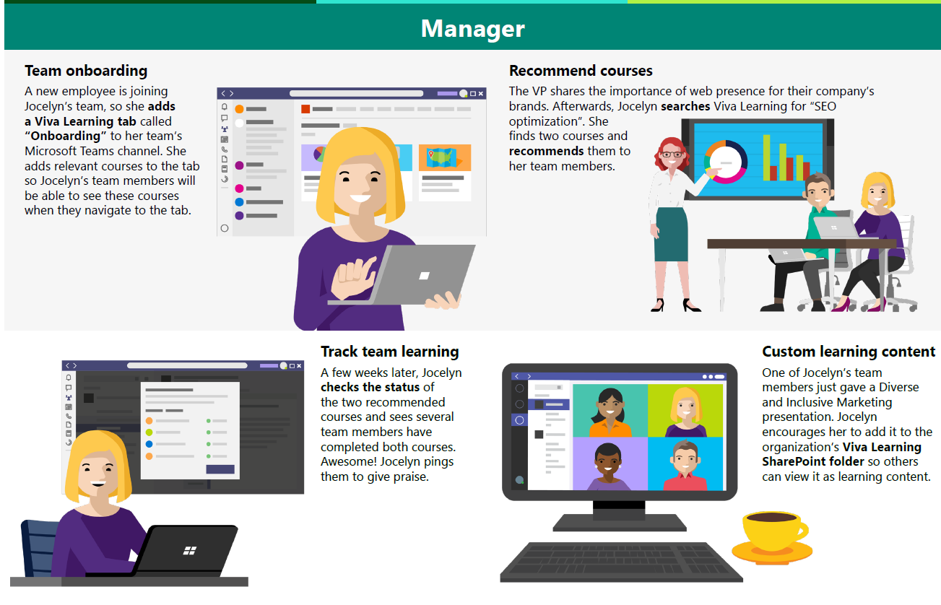
Scenario guide
Download the full guide at aka.ms/VivaLearningScenarios

Slide 11
Assess readiness
What is Readiness
Readiness assessment questions
Willingness and preparedness of your users and your organization to use Microsoft Viva Learning.
It’s important to determine how receptive your users will likely be to changing the way they work and adopting new technology. Your rollout plan should reflect the readiness of your organization.
Determine readiness by asking these questions:
What does the organization’s current learning ecosystem look like?
What were the success factors when previously rolling out new technology? What were the pitfalls?
Are there other major rollouts happening in the organization?
What internal resources can be leveraged to help spread awareness? (i.e. communication channels, training cadence, leadership events, etc.)
What are the benefits and risks with this roll out?
How can you highlight benefits?
How can you mitigate the risks?
What will the impacting changes be?
Tip: Identify these by team/user group
Readiness factors
Determining readiness and appetite for change requires:
Clear vision of organization shift
Clear vision of user shift
Amount of overall change required
Executive alignment

Slide 12
Plan

Slide 13
Define success criteria
Define goals
What are you trying to accomplish?
What does success look like?
ie. accelerate onboarding, train sales and service teams, enable upskilling across roles
Identify key performance indicator (KPIs)
These should improve based on adoption and will show leadership the impact of Microsoft Viva Learning
Establish KPI benchmarks
Determine ways to gather and measure user satisfaction and progress against benchmarks

Slide 14
KPI examples
Choose criteria to demonstrate the impact of Microsoft Viva Learning against each success measure. Below are examples of success measures, methods for measuring, and desired goals.
Success Measure | Method | Goal
Employee satisfaction Enable learning in the flow of work to increase engagement and improve satisfaction | Qualitative surveys | Higher satisfaction rating compared to satisfaction before rolling out Microsoft Viva Learning
Increased learning engagement Streamline access to learning content to increase engagement | Qualitative surveys Viva Learning admin reporting (learn more about admin reporting here) | 100 learning objects recommended in first two quarters (Viva Learning reporting) 20 learning tabs created in first two quarters (Viva Learning reporting) 2x increased avg time spent on learning per week
Increased assignment completion Streamline access to learning assignments to increase number of trainings employees complete | Qualitative surveys | 2x increase in assignments completed ahead of deadlines compared to before rolling out Microsoft Viva Learning
Increased job competency Access to relevant content to develop new skills needed to improve performance | Qualitative surveys | All employees at competency for current role
Busines outcomes Streamline employee development, onboarding, and upskilling to improve business results and employee retention | Internal business metrics (HR) | Lower cost of new hires Increased promotions Internal transfers Employee retention

Slide 15
Assemble core team
Adopting new technology requires buy-in and support from across the business. Below are key groups and team members who can help bridge technology and business outcomes that matter to your organization Each group or member has a specific role in implementation and should be engaged early and often.
Key groups
Additional core team members
Executive Sponsors
Success Owner
Early Adopters
Champions
Program Manager
Employee Training Lead
Department Leads (Stakeholders)
IT Specialists
Communications Lead

Slide 16
Assign core team R&R
Role | Responsibilities
Executive Sponsor | Communicate high-level vision and values of Microsoft Viva Learning company-wide
Success Owner | Ensure the business goals are realized from adoption of Microsoft Viva Learning
Program Manager | Oversee Microsoft Viva Learning deployment process and logistics
Early Adopters | Use Microsoft Viva Learning early on and provide feedback to help smooth out any issues ahead of broad launch to entire organization
Champions | Help evangelize Microsoft Viva Learning and manage objection handling
Employee Training Lead | Manage and communicate training content about Microsoft Viva Learning
Department Leads (Stakeholders) | Identify how department will use Microsoft Viva Learning and encourage engagement
IT Specialists | Oversee all technical aspects of the Microsoft Viva Learning deployment and rollout
Communications Lead | Oversee company-wide communications about Microsoft Viva Learning

Slide 17
Understand common adoption concerns
Concern
How does Microsoft protect the privacy and security of Viva Learning users?
Concern
How does data residency work for Viva Learning?
→
→
Resolution
With state-of-the-art encryption, Microsoft protects your data both at rest and in transit. Our encryption protocols erect barriers against unauthorized access to the data, including two or more independent encryption layers to protect against compromises of any one layer.
Your data is your business, and you can access, modify, or delete it at any time. Microsoft will not use your data without your agreement, and when we have your agreement, we use your data to provide only the services you have chosen.
Please refer to the Microsoft Trust Center (HERE) for additional information.
Resolution
Viva Learning data residency is tenant specific and follows the standard Microsoft 365 data storage guidelines by available geography. For more information, see the Where is my Microsoft 365 customer data stored docs page.
For SharePoint, we currently only support sites hosted from the home geography of the tenant. Example: A French provisioned tenant can only link to SharePoint sites hosted in France to Viva Learning.
Viva Learning is GoLocal compliant. For customers located within geographies covered by a GoLocal datacenter, Viva Learning data will be stored within that GoLocal by default.

Slide 18
Understand common adoption concerns
Concern
What is the implementation time for Viva Learning?
Concern
How does Viva Learning handle multilanguage needs?
→
→
Resolution
Implementation time varies by customer. From our experience with customers, implementation time can vary around 20 hours depending on complexity of the existing learning environment and how many learning sources/systems the customer is connecting to Viva Learning.
Resolution
The Viva Learning UI will be localized according to the users’ preferred language settings in Microsoft 365. Viva Learning supports all the same languages Teams supports. The learning content itself will not be translated, but search results and recommendations will show items from the users preferred language first, followed by the content in English.

Slide 19
Deploy

Slide 20
Know user discovery scenarios Scenario comparison: User organic discovery vs admin promotion
All scenarios
User organic discovery scenario
Click here
for customer facing guidance on
app usage
User has Microsoft or Office/Microsoft 365 account
Discovers app through search
Opens app
in Microsoft Teams
User consumes content in Viva Learning app
User shares content with other users via Teams chat
Discovers app in
left nav rail
Admin configures app for org
Admin pins app
to left nav rail
for all users
Prompts user discovery
Admin features specific content for skills learning
Click here
for more info on configuring the app
Admin promotion scenario
Key:
User
Admin

Slide 21
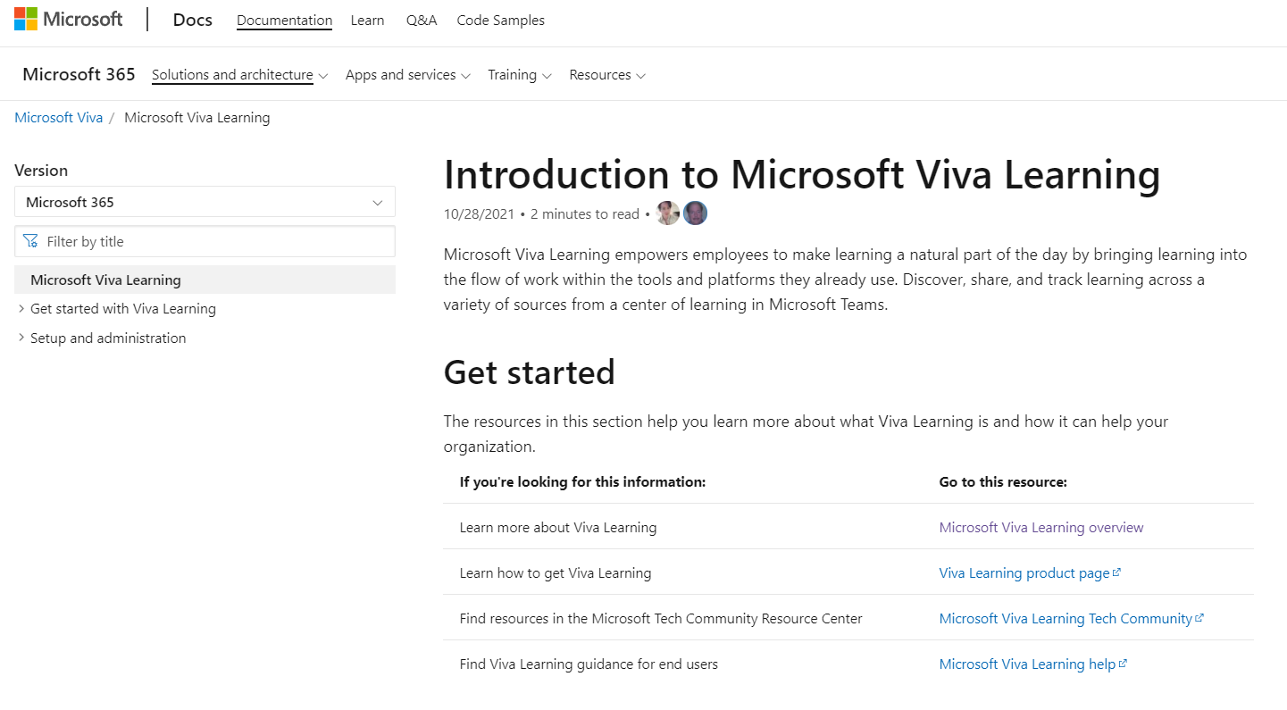
Set-up and configure Viva Learning
Click the link to access our step-by-step documentation for setting up and configuring Viva Learning
Aka.ms/VivaLearningDocs

Slide 22
Understand learning content sources- Overview
1. Microsoft owned
content sources
2. SharePoint hosted
custom content
3. 3rd party learning
content provider
4. Learning Management Systems (LMS)
Default enabled sources
LinkedIn Learning*+
Microsoft Learn
Microsoft 365 trainings
Supported file types
.doc
.ppt
.pdf
.mp4
Audio files
Announced
Skillsoft*
Pluralsight*
Coursera*
edX*
EdCast*
Harvard Bus. Publishing*
Go1*
Josh Bersin Academy*
Infosec*
OpenSesame*
Udacity*
Udemy*
Announced
Cornerstone OnDemand*
SAP SuccessFactors*
Saba*
→
→
→
A curated selection of 125 LinkedIn Learning courses are available to all Viva Learning users (full library requires LiL subscription). All users gain access to the full library of Microsoft Learn and Microsoft 365 trainings.
Admins can set up a SharePoint connection to Viva Learning to enable organization-generated resources to be discoverable and accessible in Viva Learning.
Viva Learning is being built as a fully extensible learning platform. The partners listed here are just the initial set customers can expect to have seamless integration with.
In 2022 there will also be custom APIs available so the broader learning partner ecosystem can integrate with Viva Learning, outside of pre-configured partners.
*These sources require a separately licensed subscription between your organization and the third party in order to access full library
+ Viva Learning integrates with the global content catalog licensed through LinkedIn Learning. It does not feature any tenant-specific or custom content

Slide 23
Understand learning content sources- SharePoint
To include your organization’s custom learning content in the Microsoft Viva Learning app, you’ll need to migrate your content to a connected SharePoint site.
Things to know
Tips
Any content on the SharePoint list will be pulled into the app. Microsoft Viva Learning cannot distinguish what is learning content and what is not
Microsoft Viva Learning app can pull content nested into folders up to 5 layers
To allow for broader contribution of learning content, a link to the SharePoint list will be available in the Viva Learning interface where users can request access to the list. Site owners and global administrators will have to grant access to the list.
Set permissions to list to authorize who can add content
Ensure permissions are set for content item. These will still apply when content is accessed through the app
Prioritize content sources with high potential for tacit knowledge
Migrate to a modern site that includes Microsoft Teams
If using a migration tool, use one that will move user identities. This maintains properties such as Created By or Modified By after the migration

Slide 24
Understand learning content sources- SharePoint Diagram showing SharePoint integration
Tenant’s learning content catalog
SP site/folder 1
SP site specified by admin
SP list (auto created)
__SP1 path__
__SP2 path__
__SP3 path__
SP site/folder 2
SP site/folder 3
__SPN path__
Title, thumbnails, … will be auto generated
SP site/folder N
SP Learning Pathways

Slide 25
Example deployment
Here is an example of typical deployment tasks and times based on data from the initial set of customers using Viva Learning (per Microsoft internal data):
Setup SharePoint learning site: 5 hours
Setup LMS connection: 5 hours
Setup content provider: 4 hours (can be much less than this depending if setup instructions are followed correctly)
Deploy Teams app (enabled by default): 2 hours
(Optional) Deploy licensed POC: 4 hours
Estimated total time: 16-20 hours
Notes:
Driving rationalization of the HCM suite – where VL fits in

Slide 26
Train and Adopt

Slide 27
Build training strategy
Focus on the why
Make sure employees know why the change is happening, what’s in it for them, and why they’re being asked to change.
Use real work scenarios
Use tasks or processes familiar to your audience to draw them into learning how to use the technology.
Use multiple formats
Training end users should take on multiple forms to accommodate different learning styles, geographical barriers, and resource constraints.
Reinforce
Make the training stick with reinforcement options like on-demand training, lunch and learn sessions, and new employee training options

Slide 28
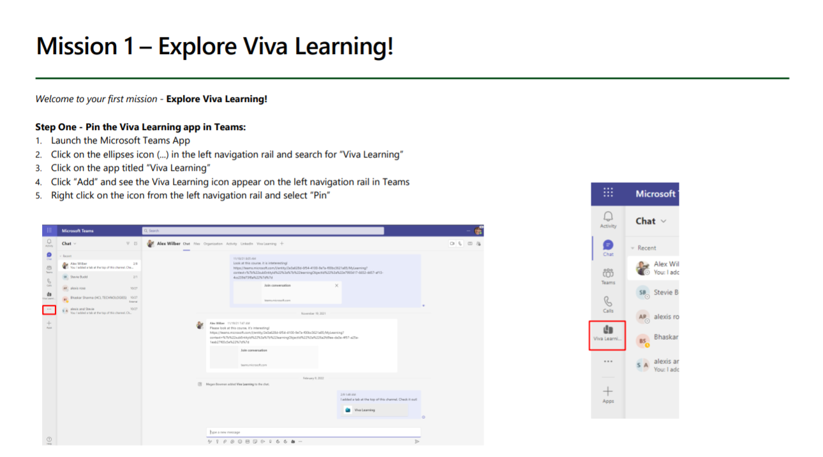
Run a pilot
Identify a user group to pilot rollout. Hold a session with your pilot group to learn about Viva Learning, learning scenarios, and a brief demo. Touch base with them regularly to gather feedback and adjust the rollout plan. Encourage them to be product advocates and start socializing Viva Learning with their peers and colleagues to generate buzz.
Share the Viva Learning Quickstart Guide with your pilot group. The Quickstart Guide features step-by-step guidance for exploring the app, and “missions” to start introducing the app to others.
→

Slide 29
Align training strategy to launch plan
Design your training strategy to scale with your launch. Start with the groups that will champion Microsoft Viva Learning and IT, before launching to the broader organization.
1
2
3
4
Audience group
Core team
Stakeholders
Company-wide
Ongoing engagement
Audience members
Success Owner
Early Adopters (pilot group)
Champions
Program Manager
Employee Training Lead
IT Specialists
Communications Lead
Executive Sponsors
Department Leads (Stakeholders)
All users
All users
Type of training
Full user and admin training
User training
User training
User training
Training methods
Live training sessions
Get started with the Viva Learning Quickstart guide
Live training sessions
Get started with the Viva Learning Quickstart guide
On-demand training sessions
Brown bag training sessions
Get started with the Viva Learning Quickstart guide
Lunch and Learns
Tips and tricks

Slide 30
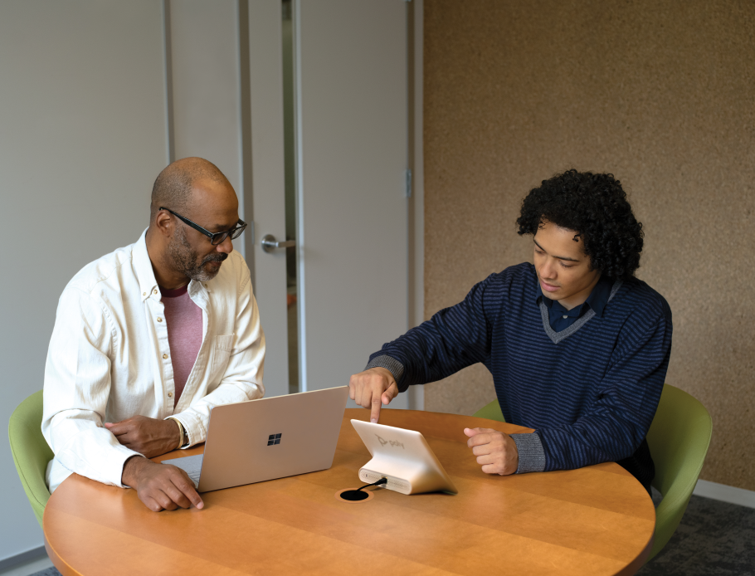
Driving a learning culture
Drive a new learning culture
Align stakeholders (HR, L&D, and IT) on learning adoption efforts. All three departments should be dedicated to driving learning at your organization.
Train leaders and managers on learning in the flow: shift attitude from learning being only for required trainings and a separate event to being part of the regular work day and for learning new skills in addition to just required trainings
Facilitate pilot rollout and “missions” to spread adoption
Keep learning dynamic and relevant
Ensure content is constantly refreshed and relevant. Maintain governance of learning content (internally hosted on SharePoint and from 3P sources)
Advise employees on learning trends, opportunities, and skills to look out for – for example, send out regular reports and suggestions on trending skills and topics
Notes:
Coordinate training and strategy between HR, L&D, and IT
Roles: learning manager, training admin,
Drive learning culture
Learning that is constantly refreshed, relevant
Keep reiterating on learning practice, measure insights and impact, survey
Put out research and guidance on opportunities that are available, skills that need to be learned, etc.

Slide 31
Awareness plan
Teaser Campaign
First Day Set Up
Tips Campaign
Campaign to raise awareness regarding the value Viva Learning will provide
Highlight scenarios of value that Viva Learning will provide to organization and key roles (refer to scenario slides in Assess section)
Generate excitement and awareness regarding the app
Gain staff buy-in for project by outlining ‘what’s in it for them’
Communication and guide(s) to help end users get set up quickly and easily
See next slide for assets
Campaign focused on key tips for Viva Learning to help employees get the most value from working in new ways
Make it top of mind for staff regarding how to work in new ways with Viva Learning
Reinforce new behaviors and resources to support – outline key stop, start, continue behaviors
Share common scenarios and use cases with the Viva Learning scenario guide
Launch/Buzz Campaigns
Campaigns to kick-off Viva Learning launch and support adoption post-launch
Scenario-focused events and email campaigns that showcase the user experience
PRE-LAUNCH
LAUNCH
POST-LAUNCH

Slide 32
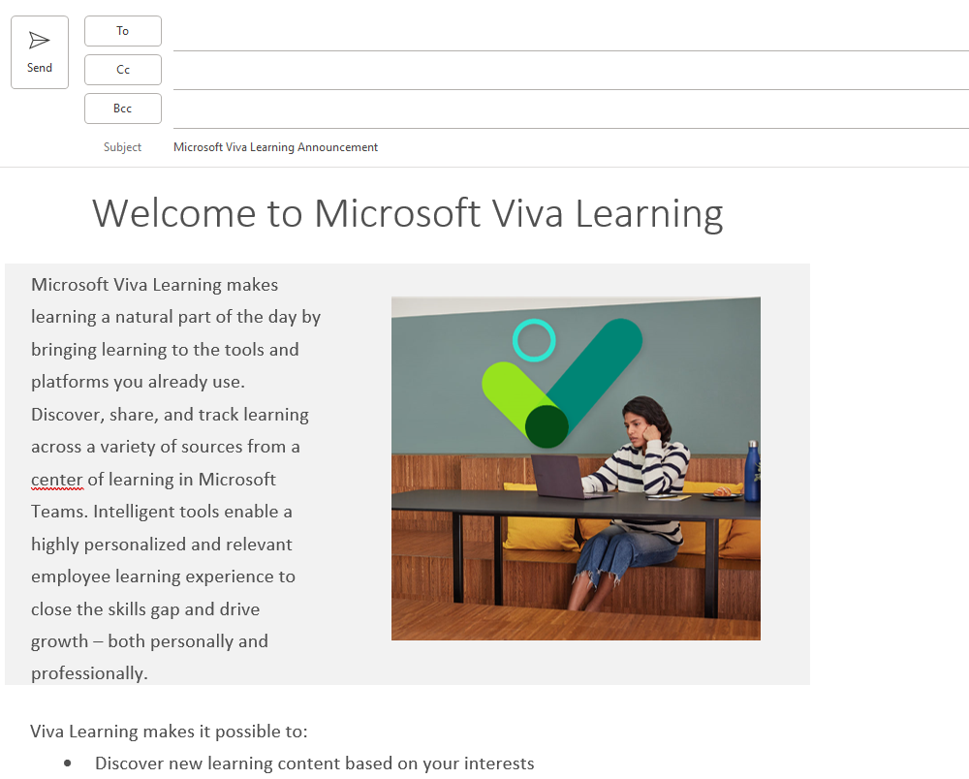
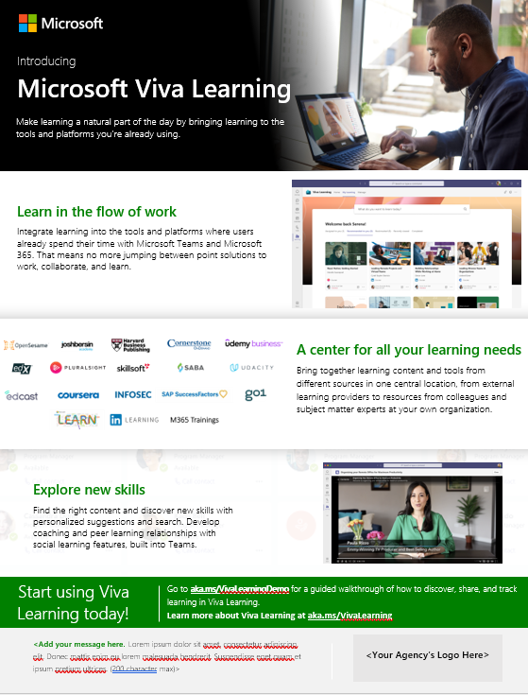
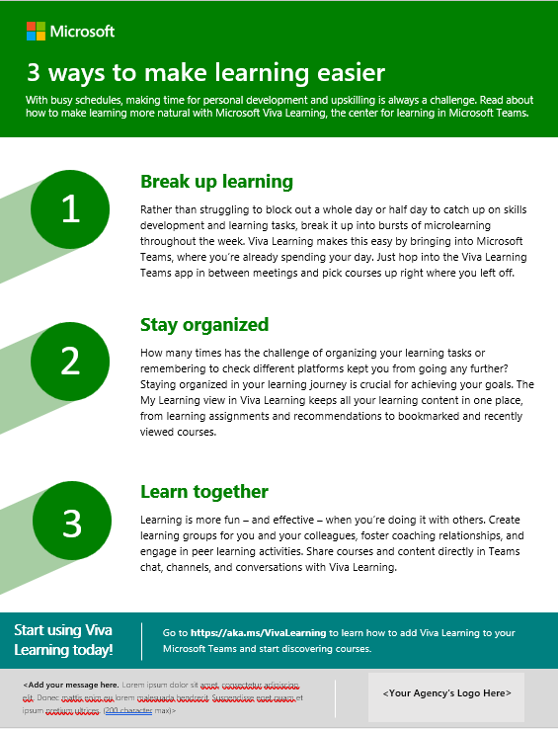
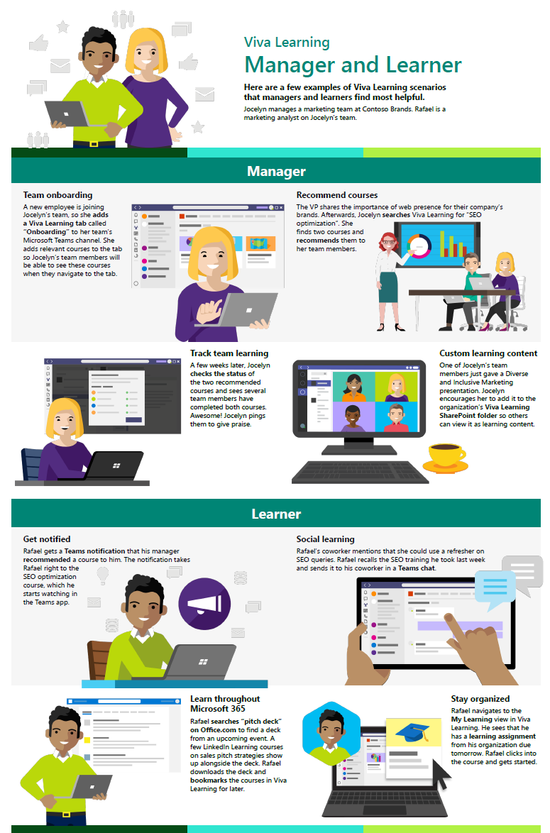
Use Available Templates/Guides
Download resources at aka.ms/VivaLearningAdoption
Viva Learning announcement email template
Intro to Viva Learning flyer
3 ways to make learning easier flyer
Viva Learning scenario guide

Slide 33
Drive value

Slide 34
Gather insights
Having a system of learning is a great opportunity to measure engagement with learning at your organization and the impacts of streamlined employee learning.
1
Leverage built-in Viva Learning reporting (available on the M365 admin center) to monitor product adoption and understand learning behavior in your organization
2
[Partner opportunity] Leverage partners/agencies or internal analyst teams to build dashboards and reporting to gather insights on learning adoption, engagement, and trends across your organization
3
Present trends and progress on KPIs identified earlier to leadership

Slide 35
Monitor satisfaction
Surveys are a great tool to gather data about user sentiment toward Microsoft Viva Learning. The results can help you determine the success of the rollout and get you thinking about necessary next steps.
1
Circulate a baseline survey shortly before users begin using Microsoft Viva Learning
2
Conduct a survey halfway through launch to gather data about users’ experiences
3
Use the results to make any necessary adjustments
4
Create new awareness or training content to address outstanding needs that arise
5
Release final survey 90 days after launch, and then in quarterly increments, to help measure user satisfaction and productivity

Slide 36
Reinforce adoption
Reinforcement is critical to make change stick.
Reminding people why this change is important isn’t the only way to motivate them to adopt the changes and turn them into the normal way of doing things.
To help reinforce adoption:
Maintain active Teams groups for your Champions
Share success stories
Host engagement events to share stories or introduce new features
Tip: Be sure to staff events with IT or Champions
Set challenges for people and run competitions

Slide 37
Deepen engagement
Cultural evolution is critical to adoption. Continuous adoption activities are the key to long term engagement.
Update examples and trainings often so employees can relate to them
Add Microsoft Viva Learning training to onboarding employee training
Teach people to use the tools as a set –talk about Microsoft Teams and Microsoft Viva Learning together
Continue to find your Champions – advocates for change within the business – including executives, managers, and admins

Slide 38
Resources

Slide 39
Other resources
Learn more about Viva Learning
Understand Employee Experience and the Viva Platform
Viva Learning is one of the 4 modules within Microsoft Viva. The Viva Learning app in Teams creates a center for learning, aggregating access to available learning resources in one place. Read the Viva Learning GA Blog for more details
Viva Learning has rich features for learners and managers to prioritize learning and development. Read the scenario guide to understand common use cases
Read the Viva Learning documentation pages for detailed guidance on technical deployment and admin setup
An Employee Experience Platform (EXP) is a system of experiences that help organizations create a thriving culture with engaged employees and inspiring leaders. Read Josh Bersin’s introduction for a helpful overview
Microsoft Viva is Microsoft’s Employee Experience Platform. Read the ebook for more information on Microsoft Viva
Demos
Check out the Viva Learning guided simulation for a walkthrough of using the product as a learner, manager, and admin

Slide 40
Thank you.

