Slide 1
Yammer end user guide

Slide 2
Table of contents
Learn how to use Yammer, a tool for connecting you with people and information across your organization.
Get started
Find discussions and communities
Participate in the conversation
Create special messages

Slide 3
Get Started Yammer is the faster, smarter way to share and collaborate with everyone at your company. Get started by customizing your profile and notification settings, then download the app to access Yammer from wherever you are.
Sign into Yammer
Edit your Yammer profile
Set notifications
Download the Yammer mobile app

Slide 4
Sign into Yammer
Set up your Yammer account to connect with people across your organization.
Inside any Office 365 application, you can access Yammer.
Click on the app launcher in the upper-left corner of your screen and select Yammer.
Click Log in and follow the steps to enter your company email and password.
You’ll soon receive a confirmation email to activate your account. Click the web address in the confirmation email to complete setup. You’ll automatically be redirected to your organization’s network.
1
The next time you sign in, you will go directly to your organization’s Yammer network.

Slide 5
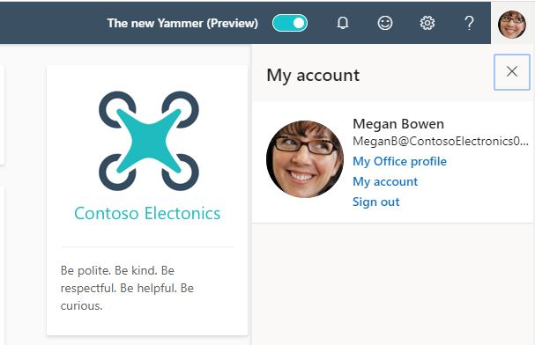
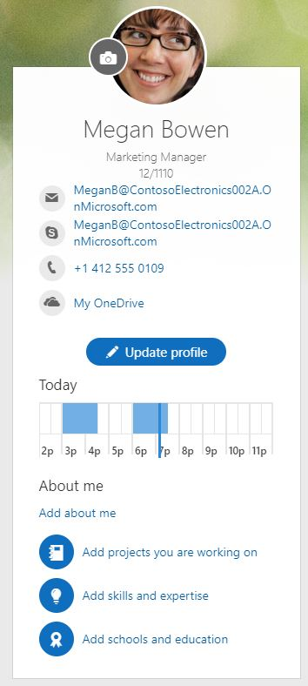
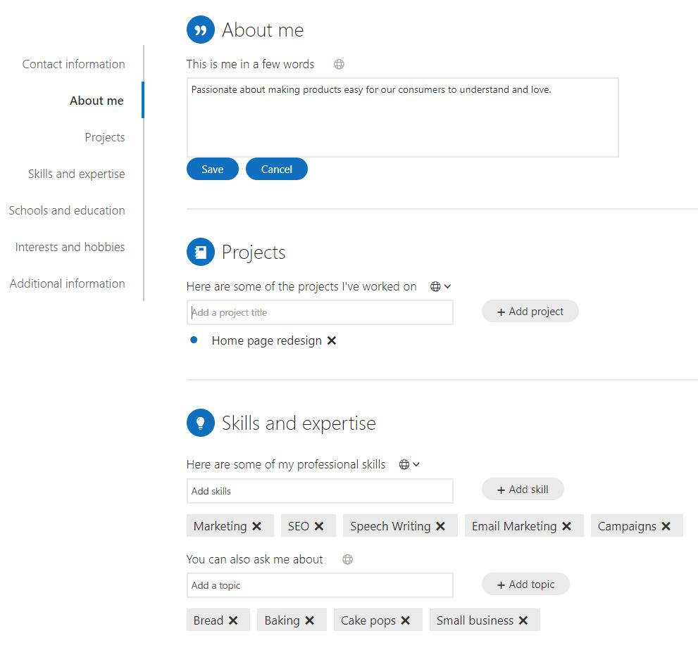
Edit your Yammer profile
1
Your Yammer profile helps coworkers learn more about you, the work you do, and your interests.
Yammer also uses your profile information to help you create connections and build a strong network.
Click on the profile icon at the top right hand and select My Office profile.
Click Update Profile to add information collaborators may find helpful, like your expertise, interests, experience.
3
2
As part of Office 365, Yammer uses your organization’s directory to automatically fill in your name, email, Office 365 profile picture, job title, department, location, and work phone number.

Slide 6
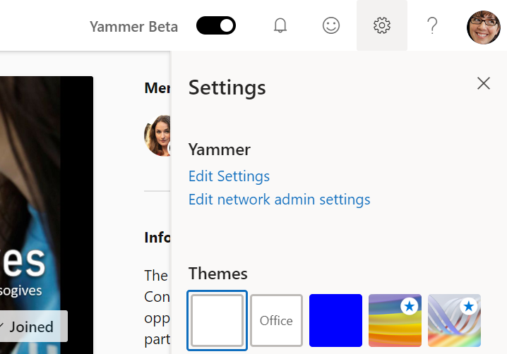
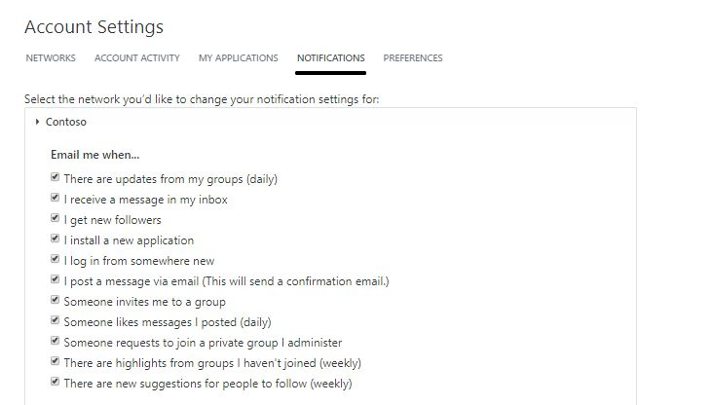
Set notifications
Never miss an important update in your Yammer network and stay up-to-date on your conversations.
Click on the gear icon on the top right-hand corner and select Edit Settings.
Configure your preferences on the Notifications tab.
Activity digest sends daily or weekly emails to help you discover new activity.
Follow communities to get notifications and messages in your Yammer inbox.
To receive the best Yammer experience in Outlook, make sure you have your email notifications set.
1
2
Pro tip: Try these notifications to stay on top of your network’s activity: “Receive a message in my inbox,” “Someone invites me to a community,” and “Someone requests to join a private community I administer.”

Slide 7
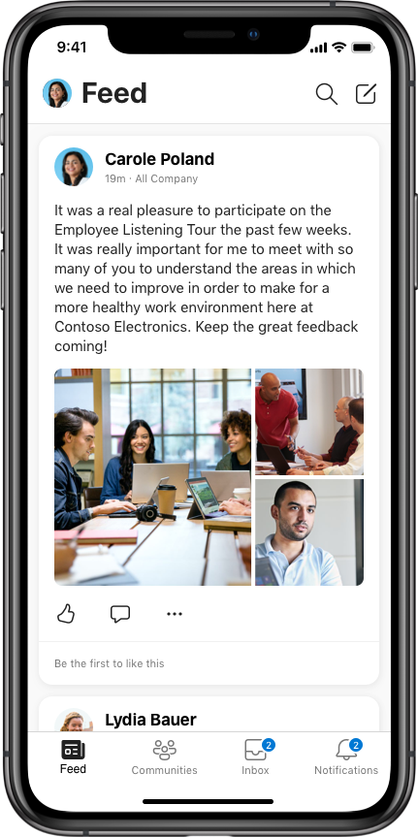
Download the Yammer mobile app
Stay connected when you’re on the go with the Yammer app.
Go to your phone’s app store, search for “Yammer,” and download the free app.
Sign in for the first time using your work email and password.
Depending on the organization's security settings, you may require you to enter your password again.
After entering your credentials for the first time, you should be able to jump right into your conversations any time you open the Yammer app.

Slide 8
Find communities and conversations
Tap into your organization’s most valuable resource—its people. Discover other communities that match your interests and find conversations and content that are relevant to you.
Discover conversations
Search for answers
Join an existing community
Create a new community

Slide 9
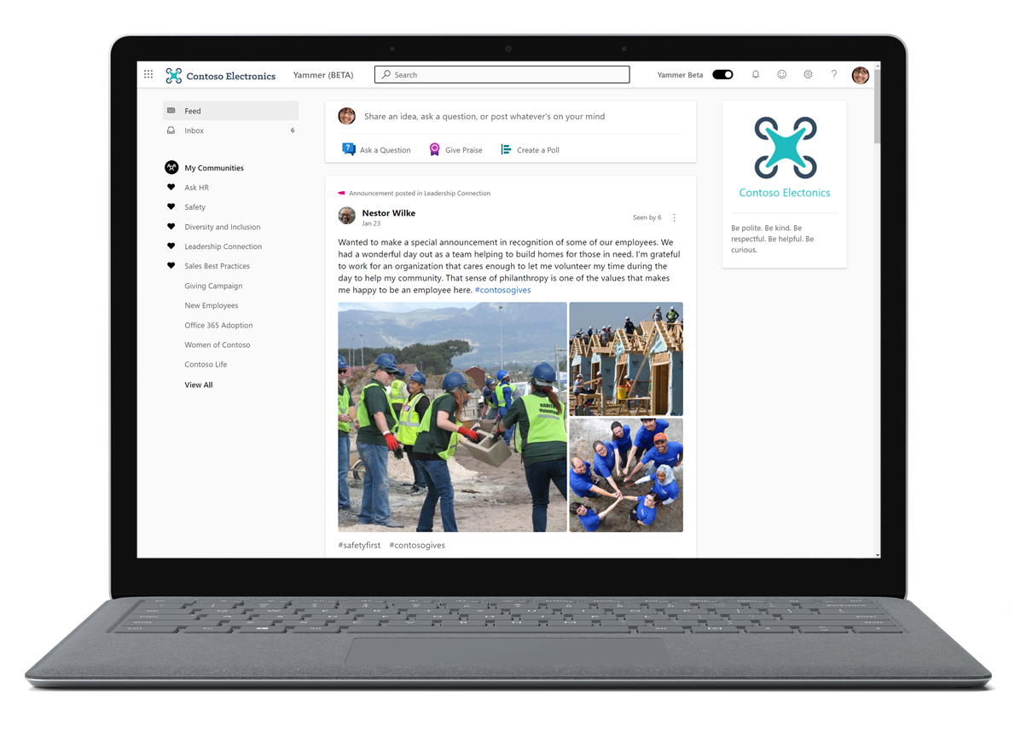
Discover conversations
Uncover helpful information through conversations happening in your network. Build off others by discovering conversations in your feed.
Click on the Yammer feed tab on the left side.
You’ll be able to scroll and scan to read through conversations happing in communities across in your Yammer network.
If you like what you are seeing and want more of that in your feed, interact, join or follow those co-workers.
Pro tip: Follow someone on Yammer to see when they post content that might be interesting to you. Just hover over their name and click the + Follow button.

Slide 10
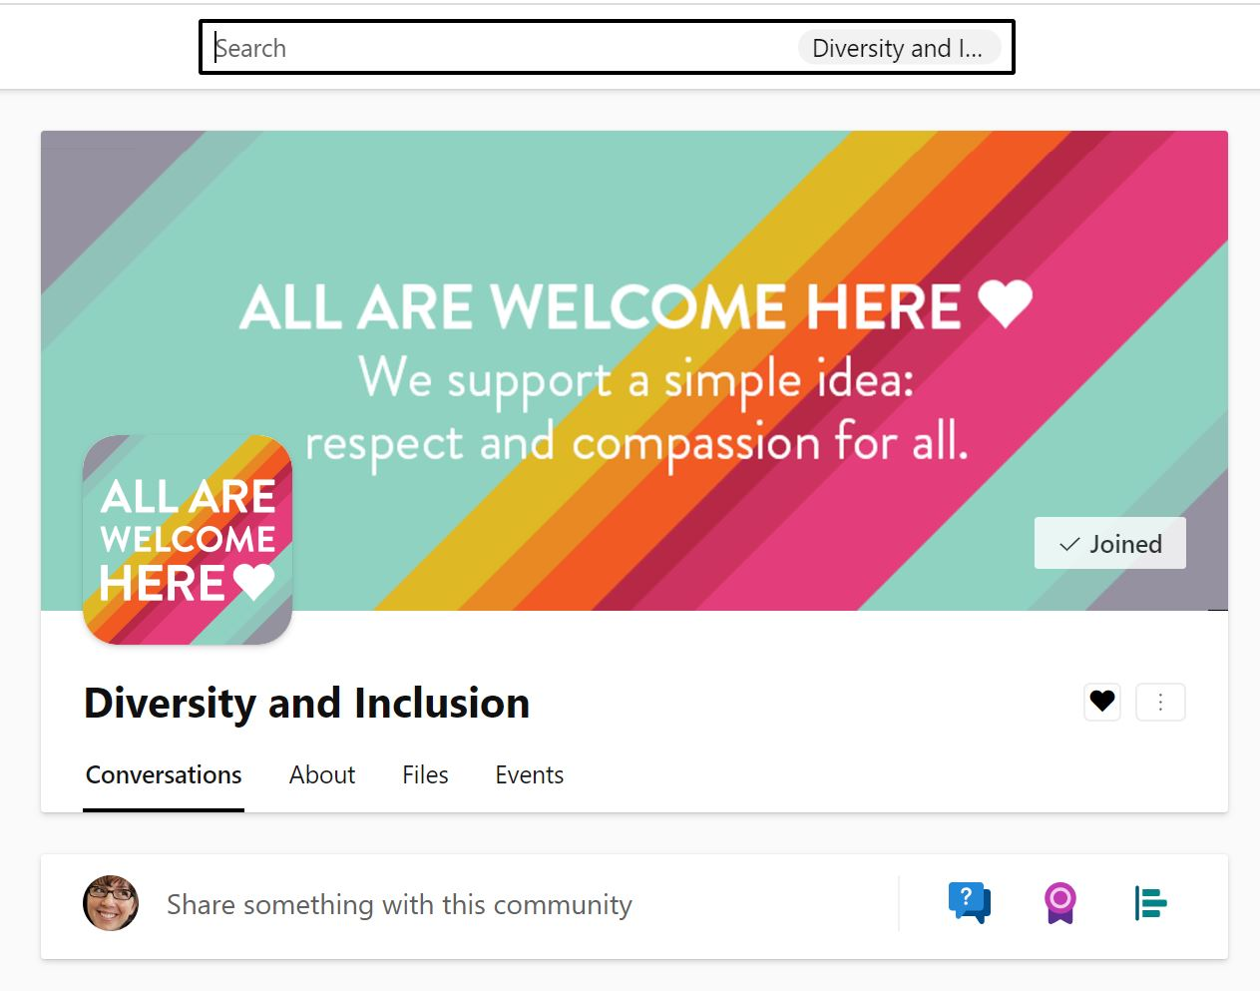
Search for answers
Search Yammer to quickly find files, conversations, people, notes, and data across your network.
Across the top of your navigation, in the Search bar, type in related keywords to find what you need. A list of categorized results is displayed with suggested conversations, communities, people and files.
If you don’t see what you’re looking for, click See all search results. Browse the complete search results, which are categorized by tabs.
You can also search directly in a community by clicking on the Search bar within the community.
1
3
Yammer connects you with the information you’re looking for and others who have similar questions.

Slide 11
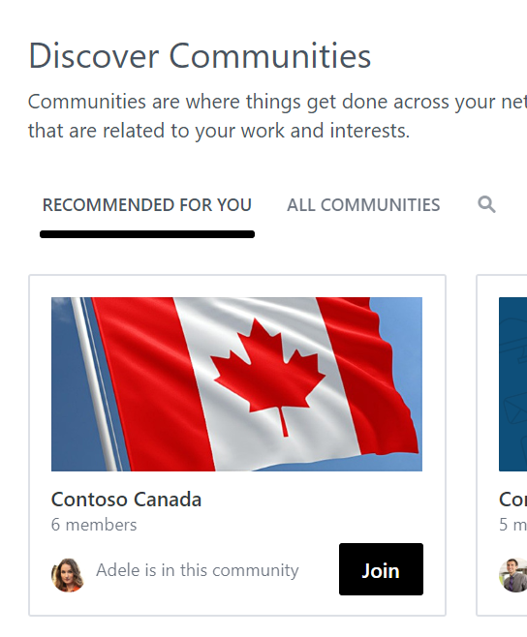
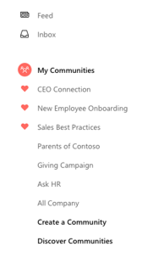
Join an existing community
2
Groups are a great way to stay informed about a topic or collaborate with communities of people. Some communities are public and easy to join, while others are private and require approval.
On the left navigation, click Discover Communities.
Browse or use Search to find communities.
Read through descriptions, scroll through the feed, or look at members to figure out if the community is relevant to you.
You are automatically part of the All Company community.
Click + Join when you find a community that interests you.
If the community is public, you will be instantly added to it; if it is private, the community administrator will need to approve your join request.
All communities you are a member of will appear in the left navigation pane. You can favorite up to 10 of your communities.
3
1

Slide 12
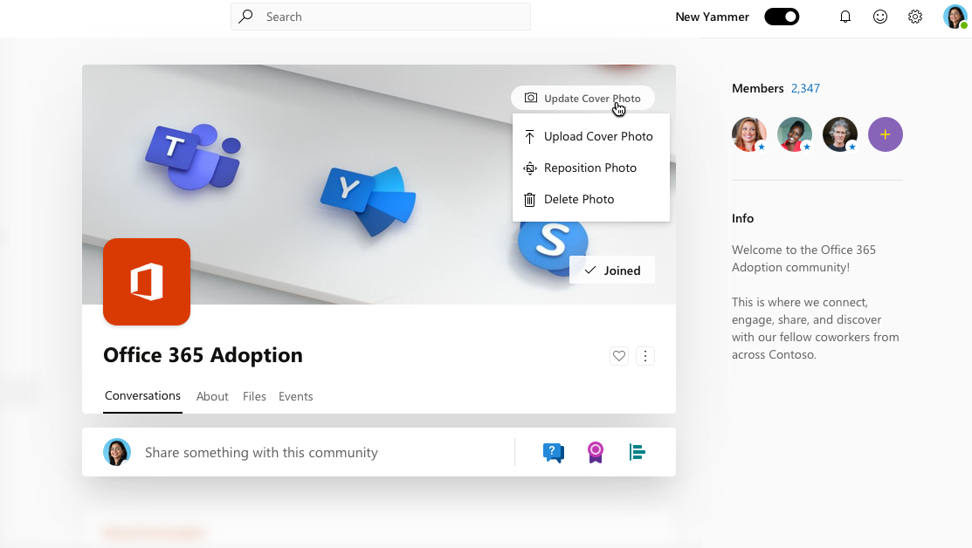
Create a new community
Don’t see a community for your interest, or want to create a community for a new initiative? Start a new community and customize it for your members.
In the left navigation, click the + sign.
Select the community type (Internal or External), type Community Name, add Community Members, and set access to Public or Private.
Customize your community information by clicking the gear icon in the community header. Edit community settings like the description, upload a community cover photo and image.
Your community is now active and will appear in your network’s list of communities
You can see the exact dimensions and view you’re the cover photo in the Cover Photo Preview Template. View more best practices on building communities in Yammer here.
3
Pro tip: You can bulk add members to a community from a CSV file in community settings.

Slide 13
Participate in the conversation
Share your learnings and ask questions.
Join in, add insight, and engage with everyone at your company.
Like and reply to posts
Post an update
Attach a file

Slide 14
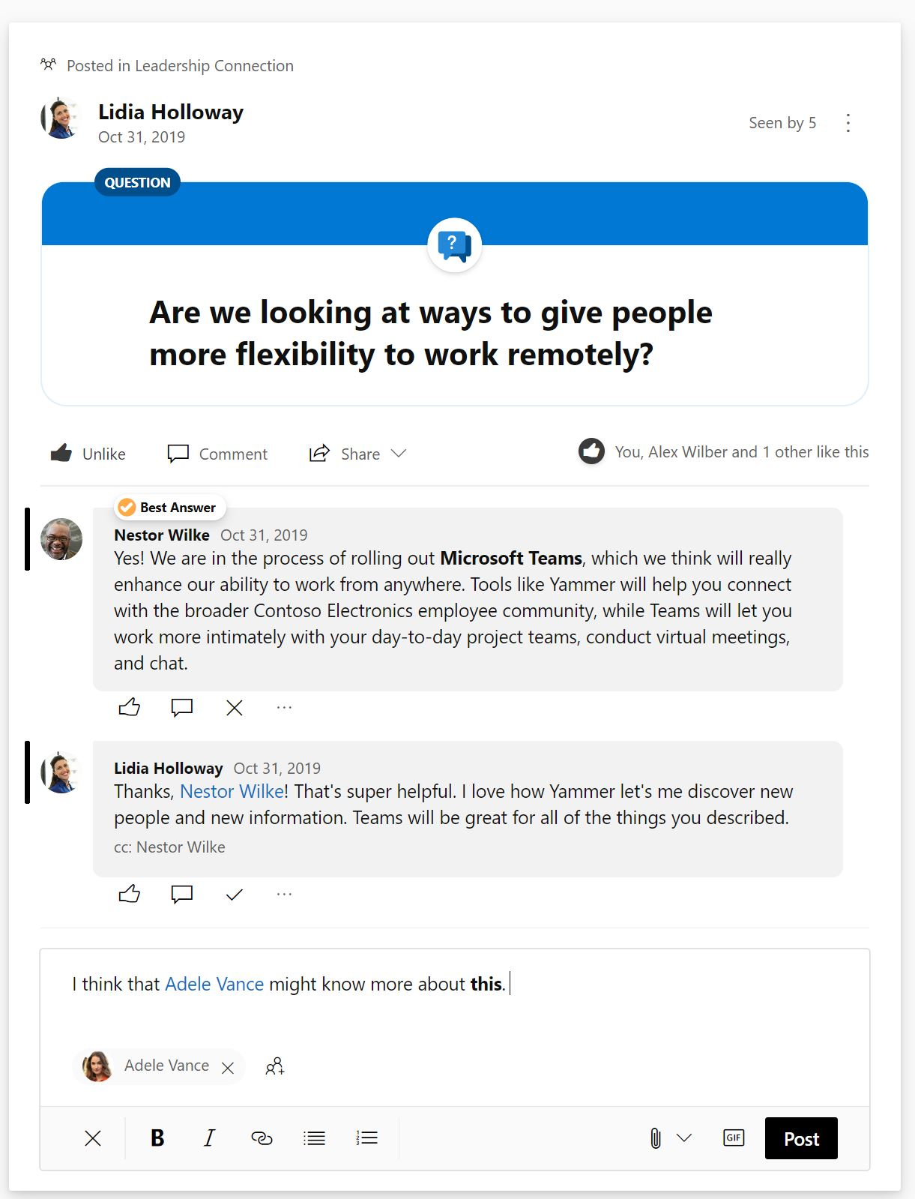
Like and reply to posts
Yammer makes it easy to engage with your colleagues and keep the conversation going wherever you are.
Click Like on a post to indicate that you agree with an idea, have seen a message, or just want to let someone know you find what they’re saying helpful. Yammer will show how many people have liked the message, including yourself.
You can either click Comment or add to the bottom to add your insights or ask a question.
@mention other people who can contribute to the conversation or would find it helpful. @mention also triggers an email by default so you can be confident they’ll see your post. You can also Notify more people of your message in the text box below.
Click Post.
1
2
3
4
Pro tip: Yammer helps you reply to the right person when there are already several replies; look at the top of the Reply box to see who you’re replying to. Yammer also lets people know when you’re replying directly to them.
Your reply will appear in the conversation thread.

Slide 15
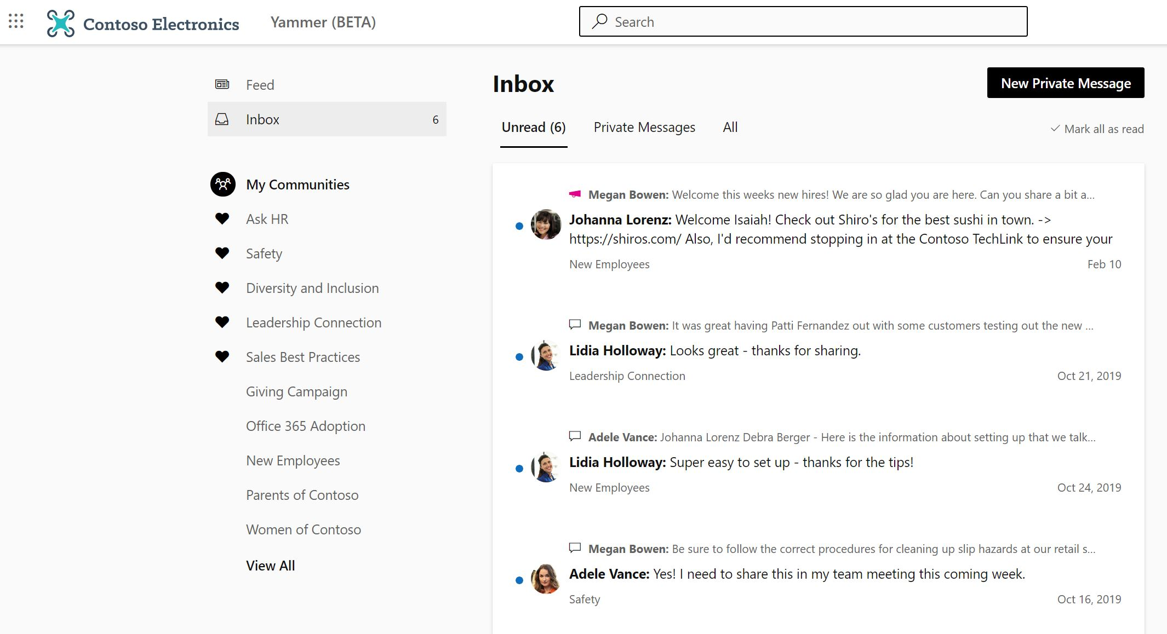
Manage your inbox
When colleagues reply to messages you’ve posted or @mentioned you in specific conversation, you’ll see these messages in your Inbox.
Click on Inbox to go directly to the conversations you’ve been pulled into.
You can view Unread and click on the message to go to that community to respond directly and keep the conversation going. You can also Mark all as read.
You can start private messages from within your Inbox.
Announcements from your communities will also be included in your Inbox.
1
3
2
You can also Mark All as Read within your Inbox.

Slide 16
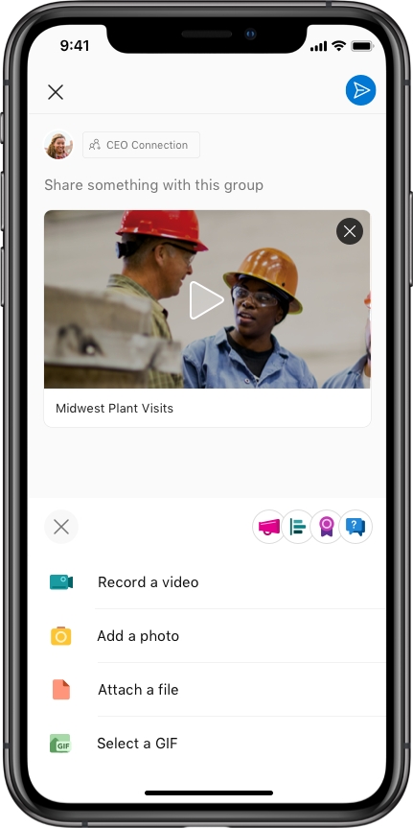
Post an update
1
Start a new conversation by sharing updates and information others across your organization will find useful or interesting.
On web and desktop, click in the box at the top of the community and enter your message.
On mobile, click on the Post pencil icon on the upper-right side of the community and type in your message.
Upload videos, attach photos, and documents for context or collaboration. Use the rich text editing tools to emphasize text or add hyperlinks.
Add relevant #Hashtags (type ‘#’) topics to the message to help others discover your update.
When you have finished, click Post.
5
2
Pro tip: If you make a mistake, you can click Edit to alter your original post.
Your post and any files you’ve shared will appear in the community feed.

Slide 17
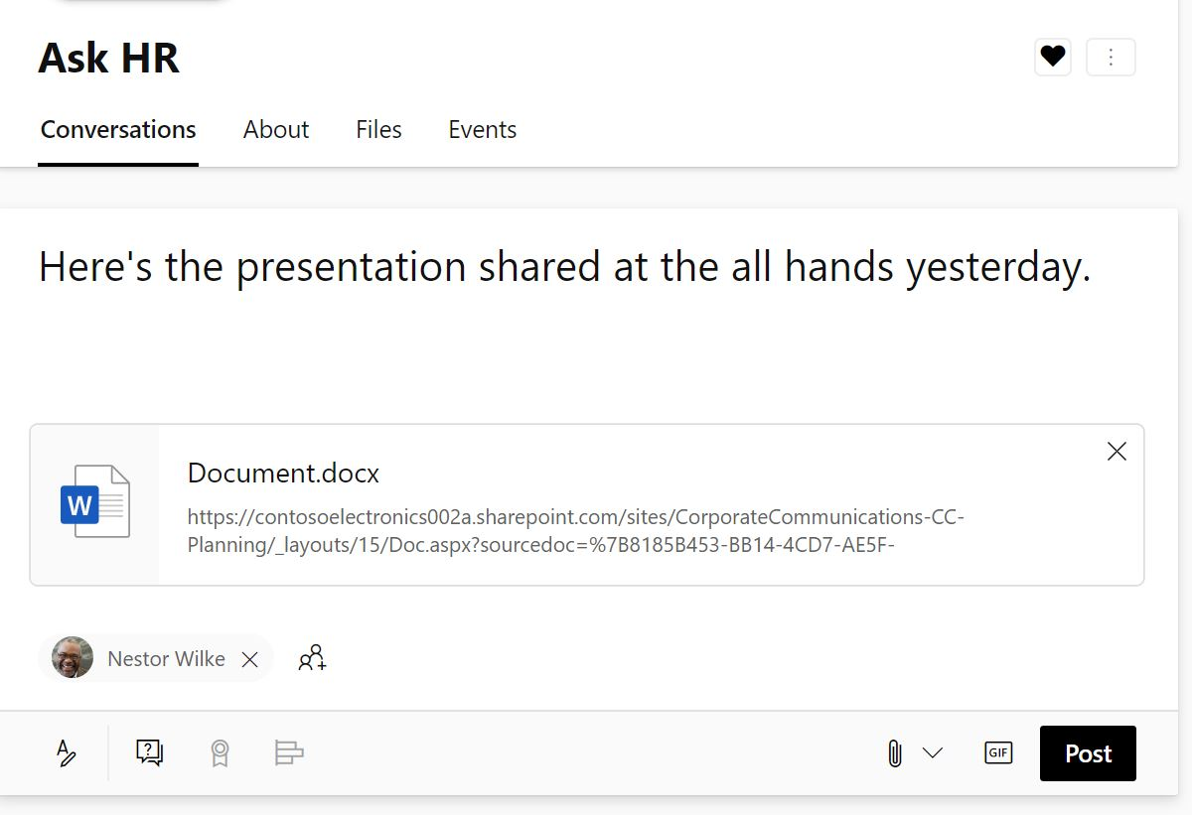
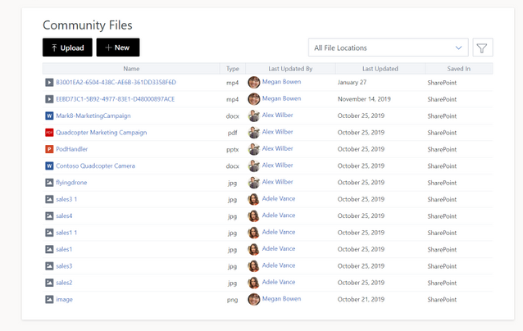
Attach a file
Easily share resources for others to leverage or get feedback on your work in real time.
Click the Attach paperclip icon inside the Update or Reply text box.
Select a file location (your computer, Yammer, or SharePoint).
Locate the file and click Select.
Type a message to give context to your colleagues, and @mention people who will find the file helpful, if you like.
Click Post.
1
3
The file will be embedded into the thread.

Slide 18
Create special messages
Yammer offers a variety of ways to interact with the people in your network.
Create a Poll
Praise a collaborator
Make an announcement
Share a conversation

Slide 19
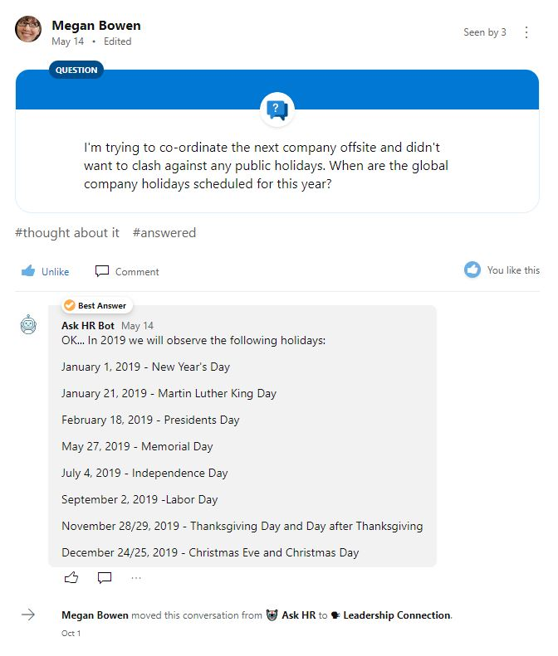
Ask a question
Have a question you’d like to ask? Need to find the source of truth? Use a question to ask to get answers fast.
At the top of the community page, click Question.
Type your question.
Click Post.
Your colleagues can reply or @mention someone who may have the right answer.
Once you’ve received the correct answer, mark Best Answer.
Questions within a community can be filtered, so you can see other questions that still need answers.
Pro tip: Using the Question’s post helps bring attention to specific questions within a busy community.

Slide 20
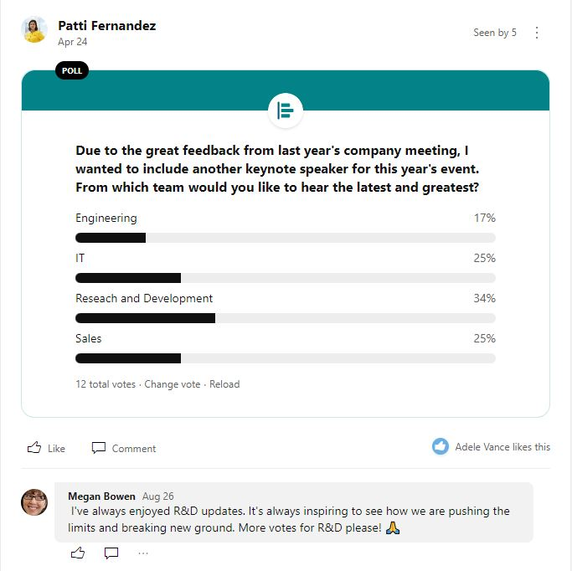
Create a Poll
Need to crowdsource feedback, or want to get a pulse on your company? Use polls to create a quick survey and get answers fast.
At the top of the community page, click Poll.
Type your question and options for answers. Click Post.
Your collaborators can vote on your poll by selecting an answer option and clicking Vote. Don’t worry, Yammer won’t show who voted for what option. You can always change your vote if needed.
Once posted, click Go to results, Change vote or Reload.
3
4
Your poll results and conversation about the poll appear in the community feed.
Pro tip: Yammer recalculates the percentage of responses, so the numbers are updated every time the community page is refreshed.

Slide 21
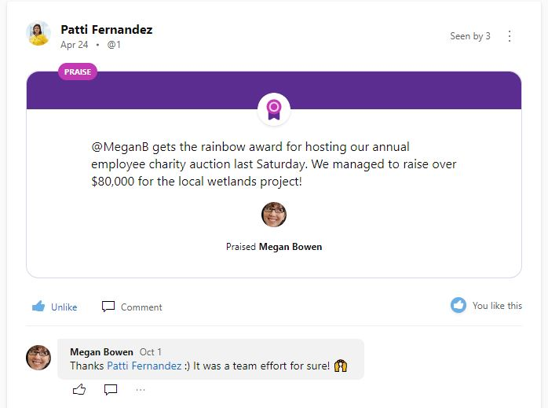
Praise a collaborator
Good work should always be recognized. Praise people in your community who have shared valuable business knowledge or skills or celebrate successes.
At the top of the community page, select Praise to display the Praise dialog box.
Enter the name of the person you want to praise in the top box. You can enter more than one name.
Use the left and right arrows to select a fun praise image.
Enter your message in the lower box, where it asks, What are you praising them for?
It’s a good idea to add the person’s supervisor to the Add people to notify box so they have visibility into a job well done.
Attach a file or Add Topics, if you like. When done, click Post.
Pro tip: You can Praise multiple people in the same post.
Your Praise will appear in the community’s feed.

Slide 22
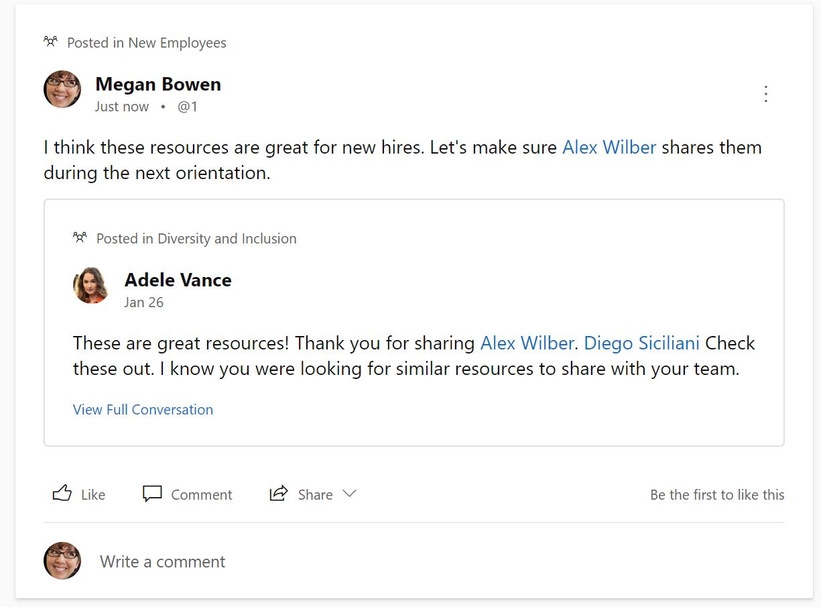
Share a conversation
1
Share conversation threads across communities to add even more voices to the conversation. Sharing threads builds on existing conversations instead of fragmenting them around the same topic.
On an existing post, click Share.
In the window, select Post in a Community or Send Private Message.
Enter a personalized message in the Say something about this conversation box.
If you are sharing to a community, Select a community from the drop-down menu.
Notify specific people and Add files, if you like.
Click Share.
3
4
5
6
The conversation will now appear in the feed of the community you specified or as a Private Message to the specified recipients. Now your collaborators can reference and join the conversation.
Pro tip: Yammer displays the number of times the conversation has been shared at the top of the thread.

Slide 23
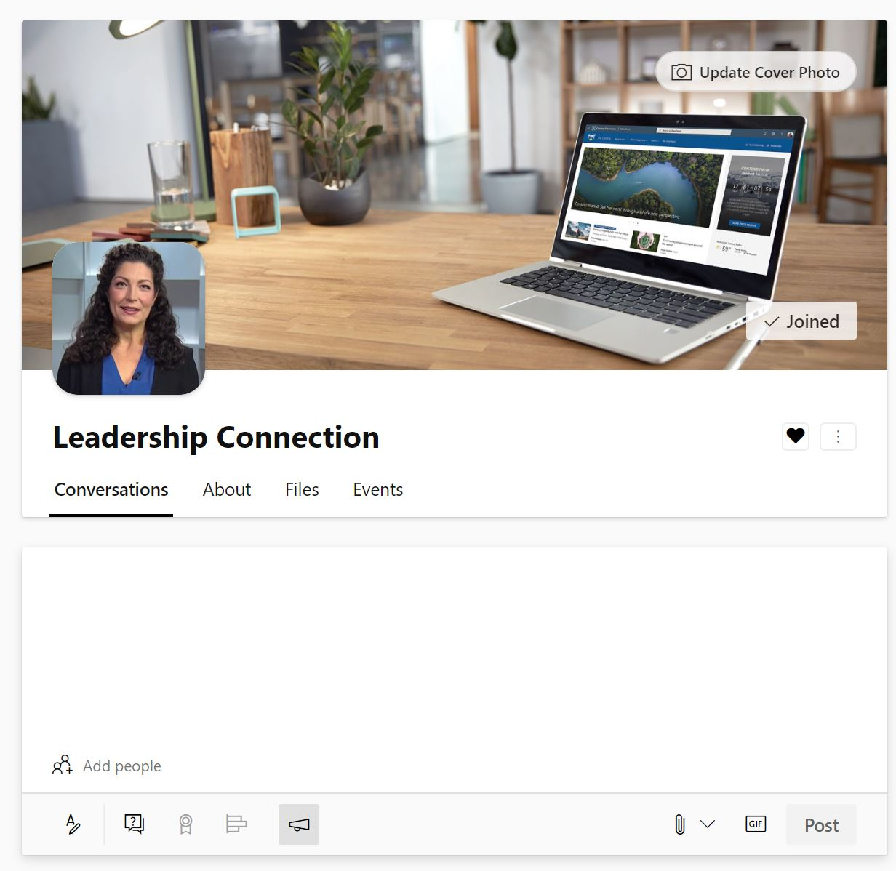
Make an announcement
Community administrators can mark any post as an announcements to share need-to-know information with the entire community.
Type out your post, question, praise or poll and then select the Announcement option.
Attach a file, Notify specific people, or Add topics, if you like.
Click Post.
1
2
5
Pro tip: Office 365 Network Admins can make an announcement in any community, including All Company.
Members will see a notification about the announcement in their inbox and receive an email by default.

